Slide 1
Sentence Parsing
Seung Jun Moon
삼성 DS-KAIST AI Expert 프로그램

Slide 2
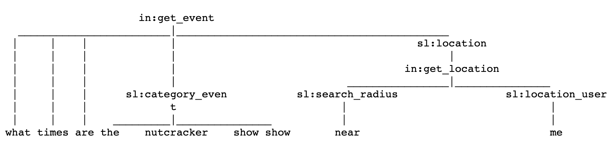
Sentence Parsing
Goal of this lecture is …

Slide 3
Table of Contents
Preprocessing
Sentence Parsing with LSTM seq2seq
Sentence Parsing with Transformer

Slide 4
Table of Contents
Preprocessing
Sentence Parsing with LSTM seq2seq
Sentence Parsing with Transformer

Slide 5
Preprocessing
Dataset is consist of rows of
Raw Sentence
Tokenized Sentence
Parsed Sentence

Slide 6
Preprocessing
Load a Pretrained word embedding vector.
glove.840B.300d.txt contains 300-dimensional vectors of words.
Let’s save it into a numpy array file ‘word.npy’.

Slide 7
Table of Contents
Preprocessing
Sentence Parsing with LSTM seq2seq
Sentence Parsing with Transformer

Slide 8
Sentence Parsing with LSTM seq2seq
Seq2seq Model
Pretrained with Glove

Slide 9
Sentence Parsing with LSTM seq2seq
Seq2seq Model for sentence parsing
Attention Layer
Pretrained with Glove

Slide 10
Sentence Parsing with Transformer
What is Attention?

Slide 11
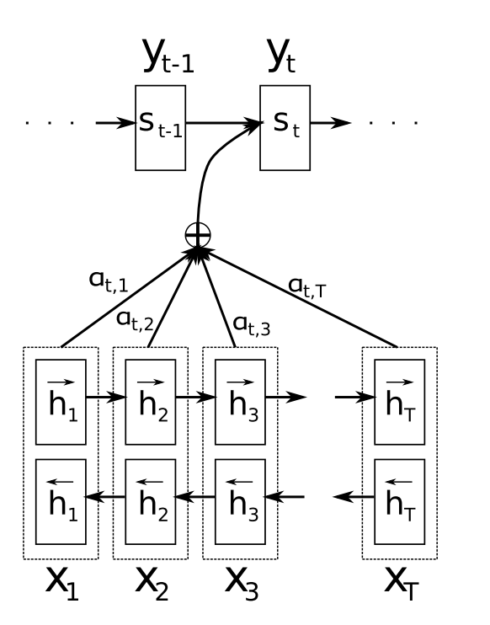
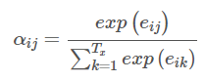
Attention Mechanism
Query
Key = Value

Slide 12

Attention Mechanism
Score for similarity between $s_{i−1} and h_{i}$

Slide 13
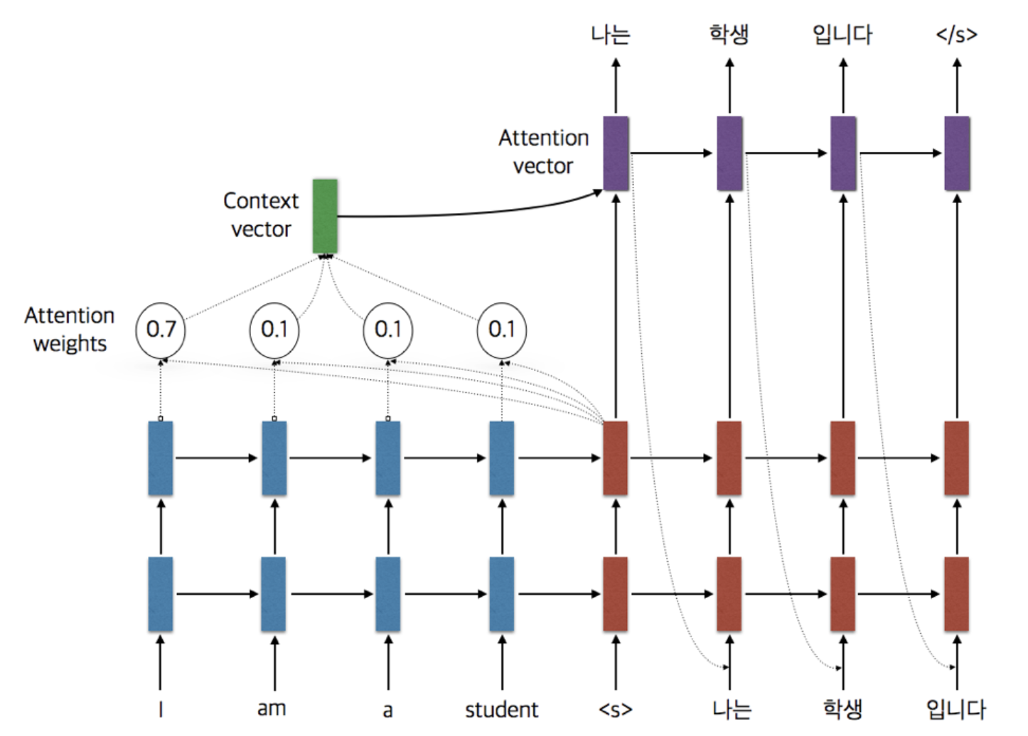
Attention Mechanism

Slide 14
Sentence Parsing with LSTM seq2seq
Seq2seq Model for sentence parsing
Attention Mechanism

Slide 15
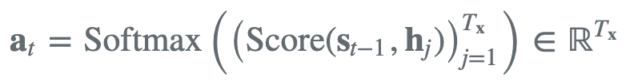
Sentence Parsing with LSTM seq2seq
Seq2seq Model for sentence parsing
Bahdanau Attention Mechanism
Alignment vector :
Hidden state at t-1

Slide 16
Sentence Parsing with LSTM seq2seq
Seq2seq Model for sentence parsing
Bahdanau Attention Mechanism
Alignment vector
Hidden state at t

Slide 17
Table of Contents
Preprocessing
Sentence Parsing with LSTM seq2seq
Sentence Parsing with Transformer

Slide 18
Sentence Parsing with Transformer
Transformer Model for sentence parsing
Encoder output

Slide 19
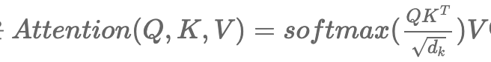
Sentence Parsing with Transformer
Self Attention of Transformer

Slide 20
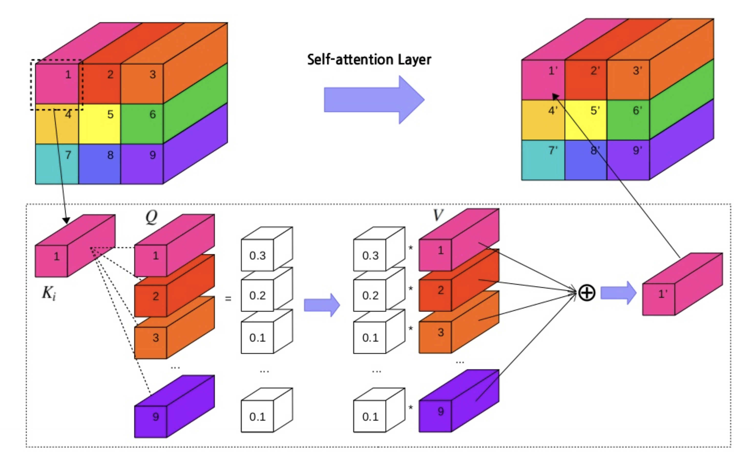
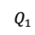
Self-Attention Mechanism
Queue = Key = Value
K
$$Q_{1}$$

Slide 21
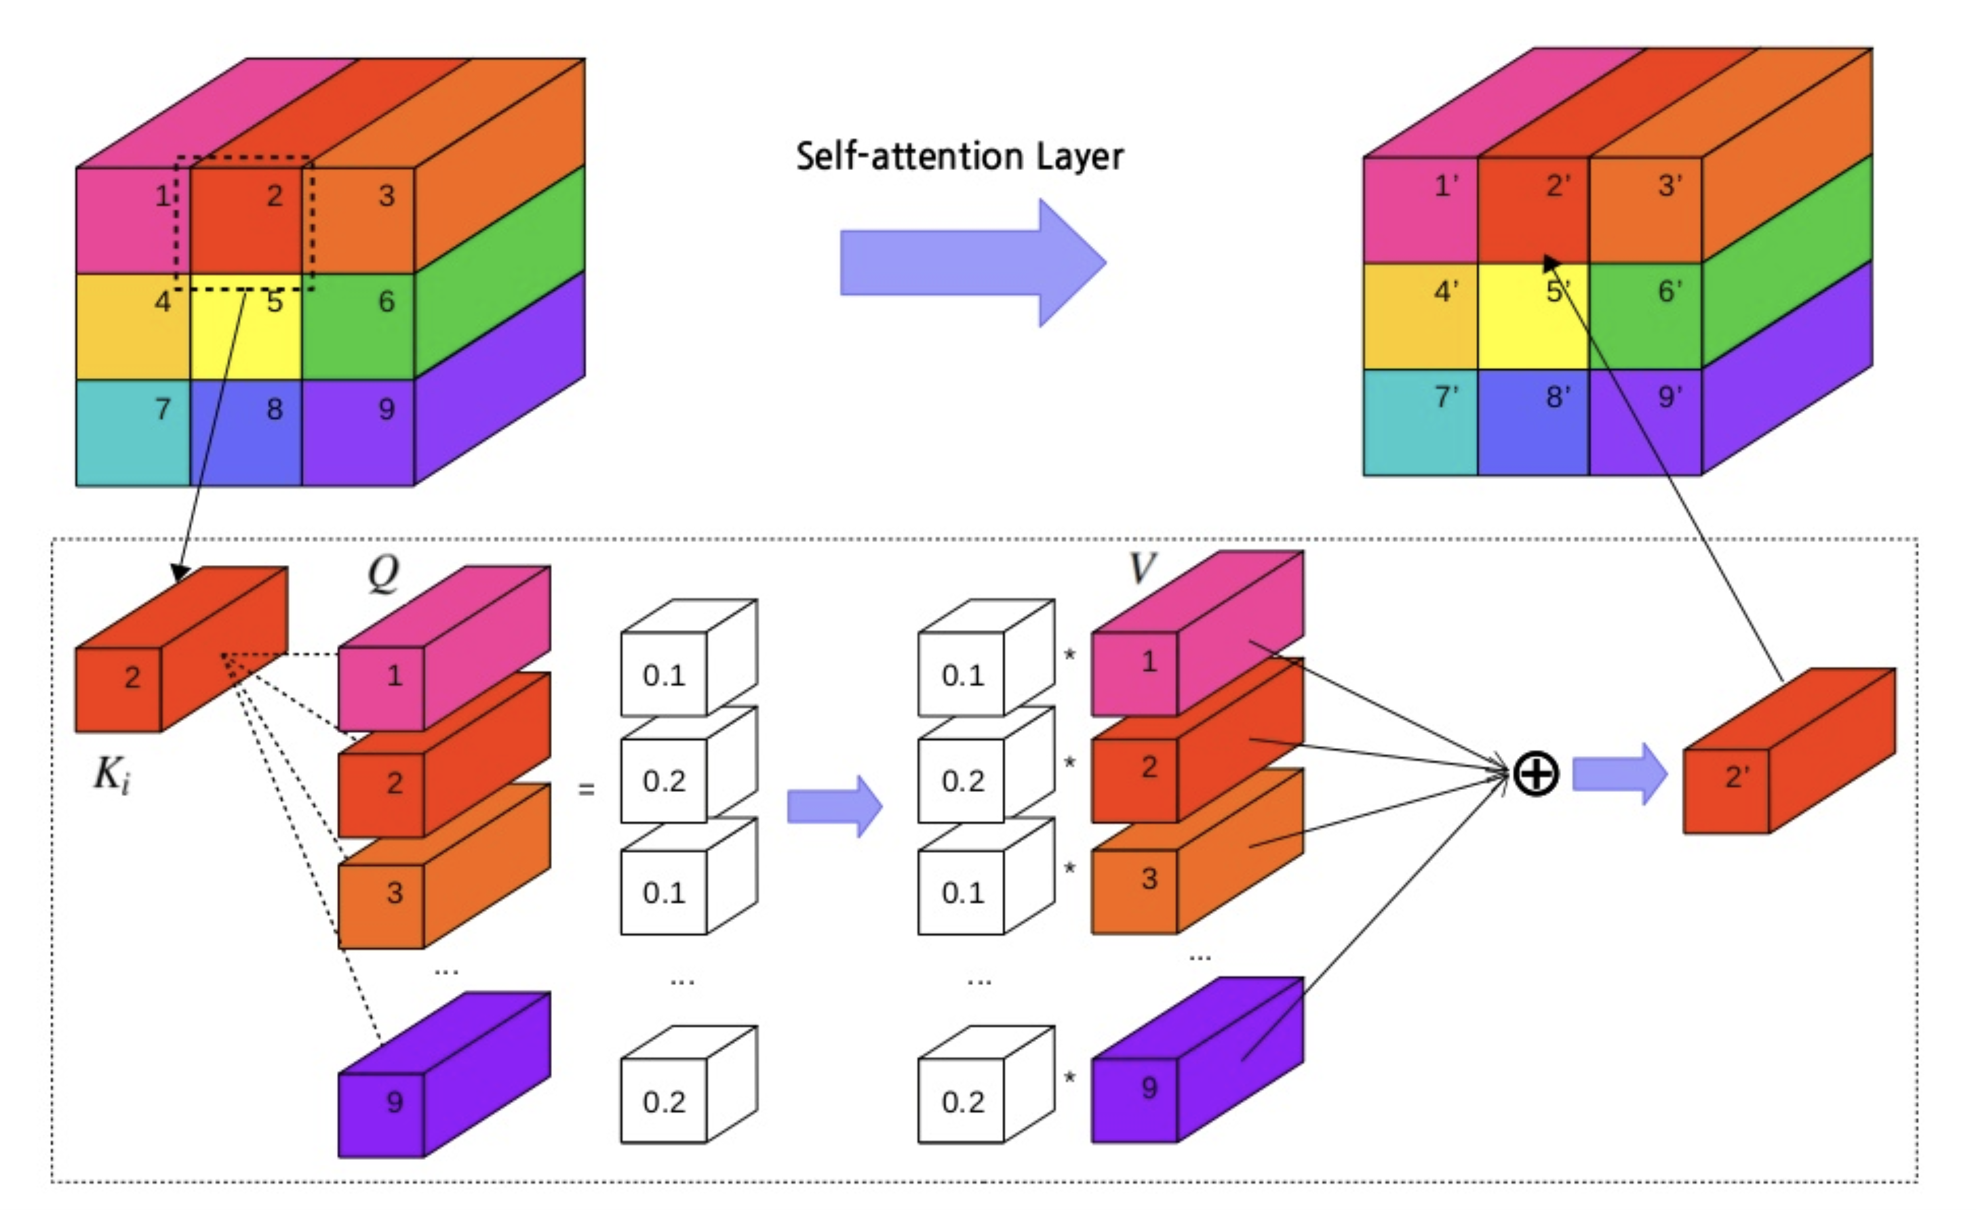
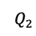
Self-Attention Mechanism
K
$$Q_{2}$$

Slide 22
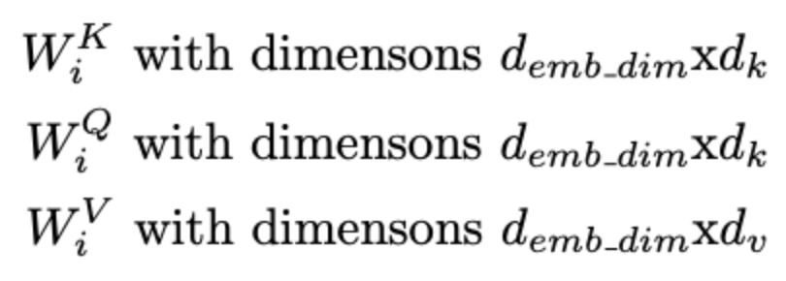
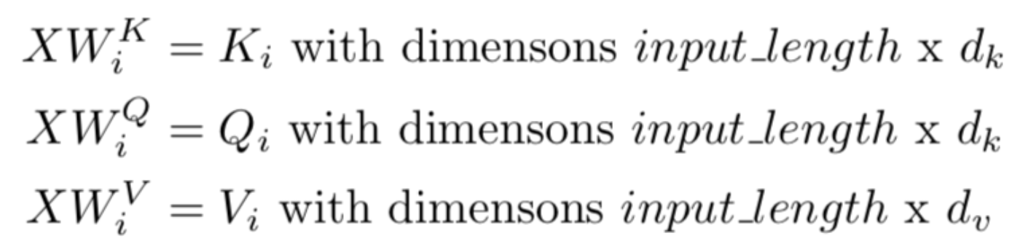
Multi-Head Attention
Projection for h times (h : number of head)

Slide 23
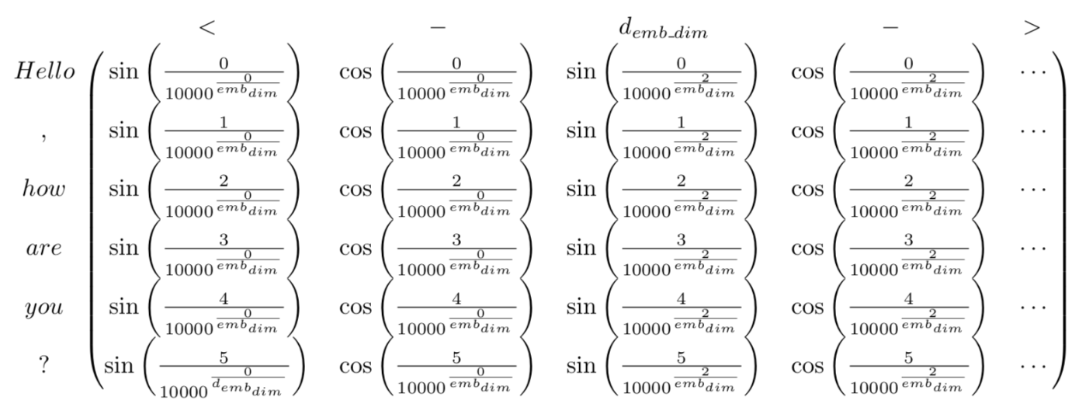
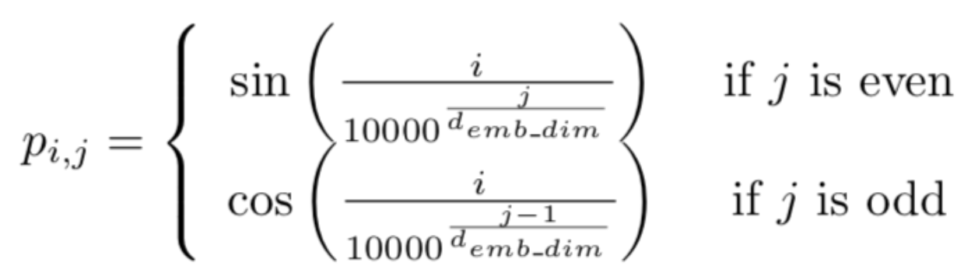
Positional Encoding
No RNN structure → We need position encoding!
Position Encoding
P

